Slide 1
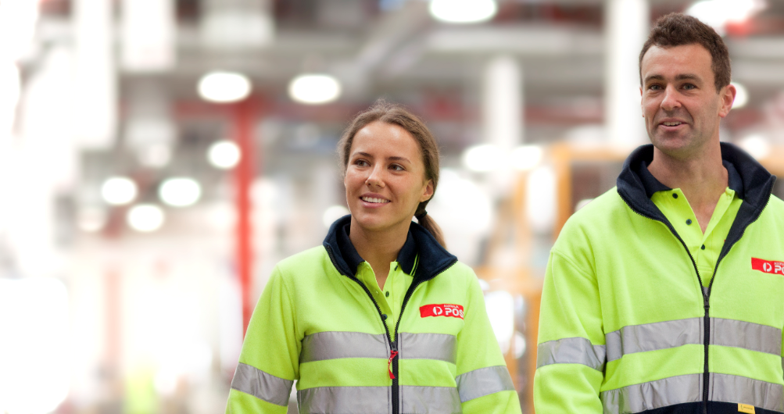


An Introduction to becoming an
Safety Advocate
2021
Last Updated: 13.10.2021-V1.1

Slide 2
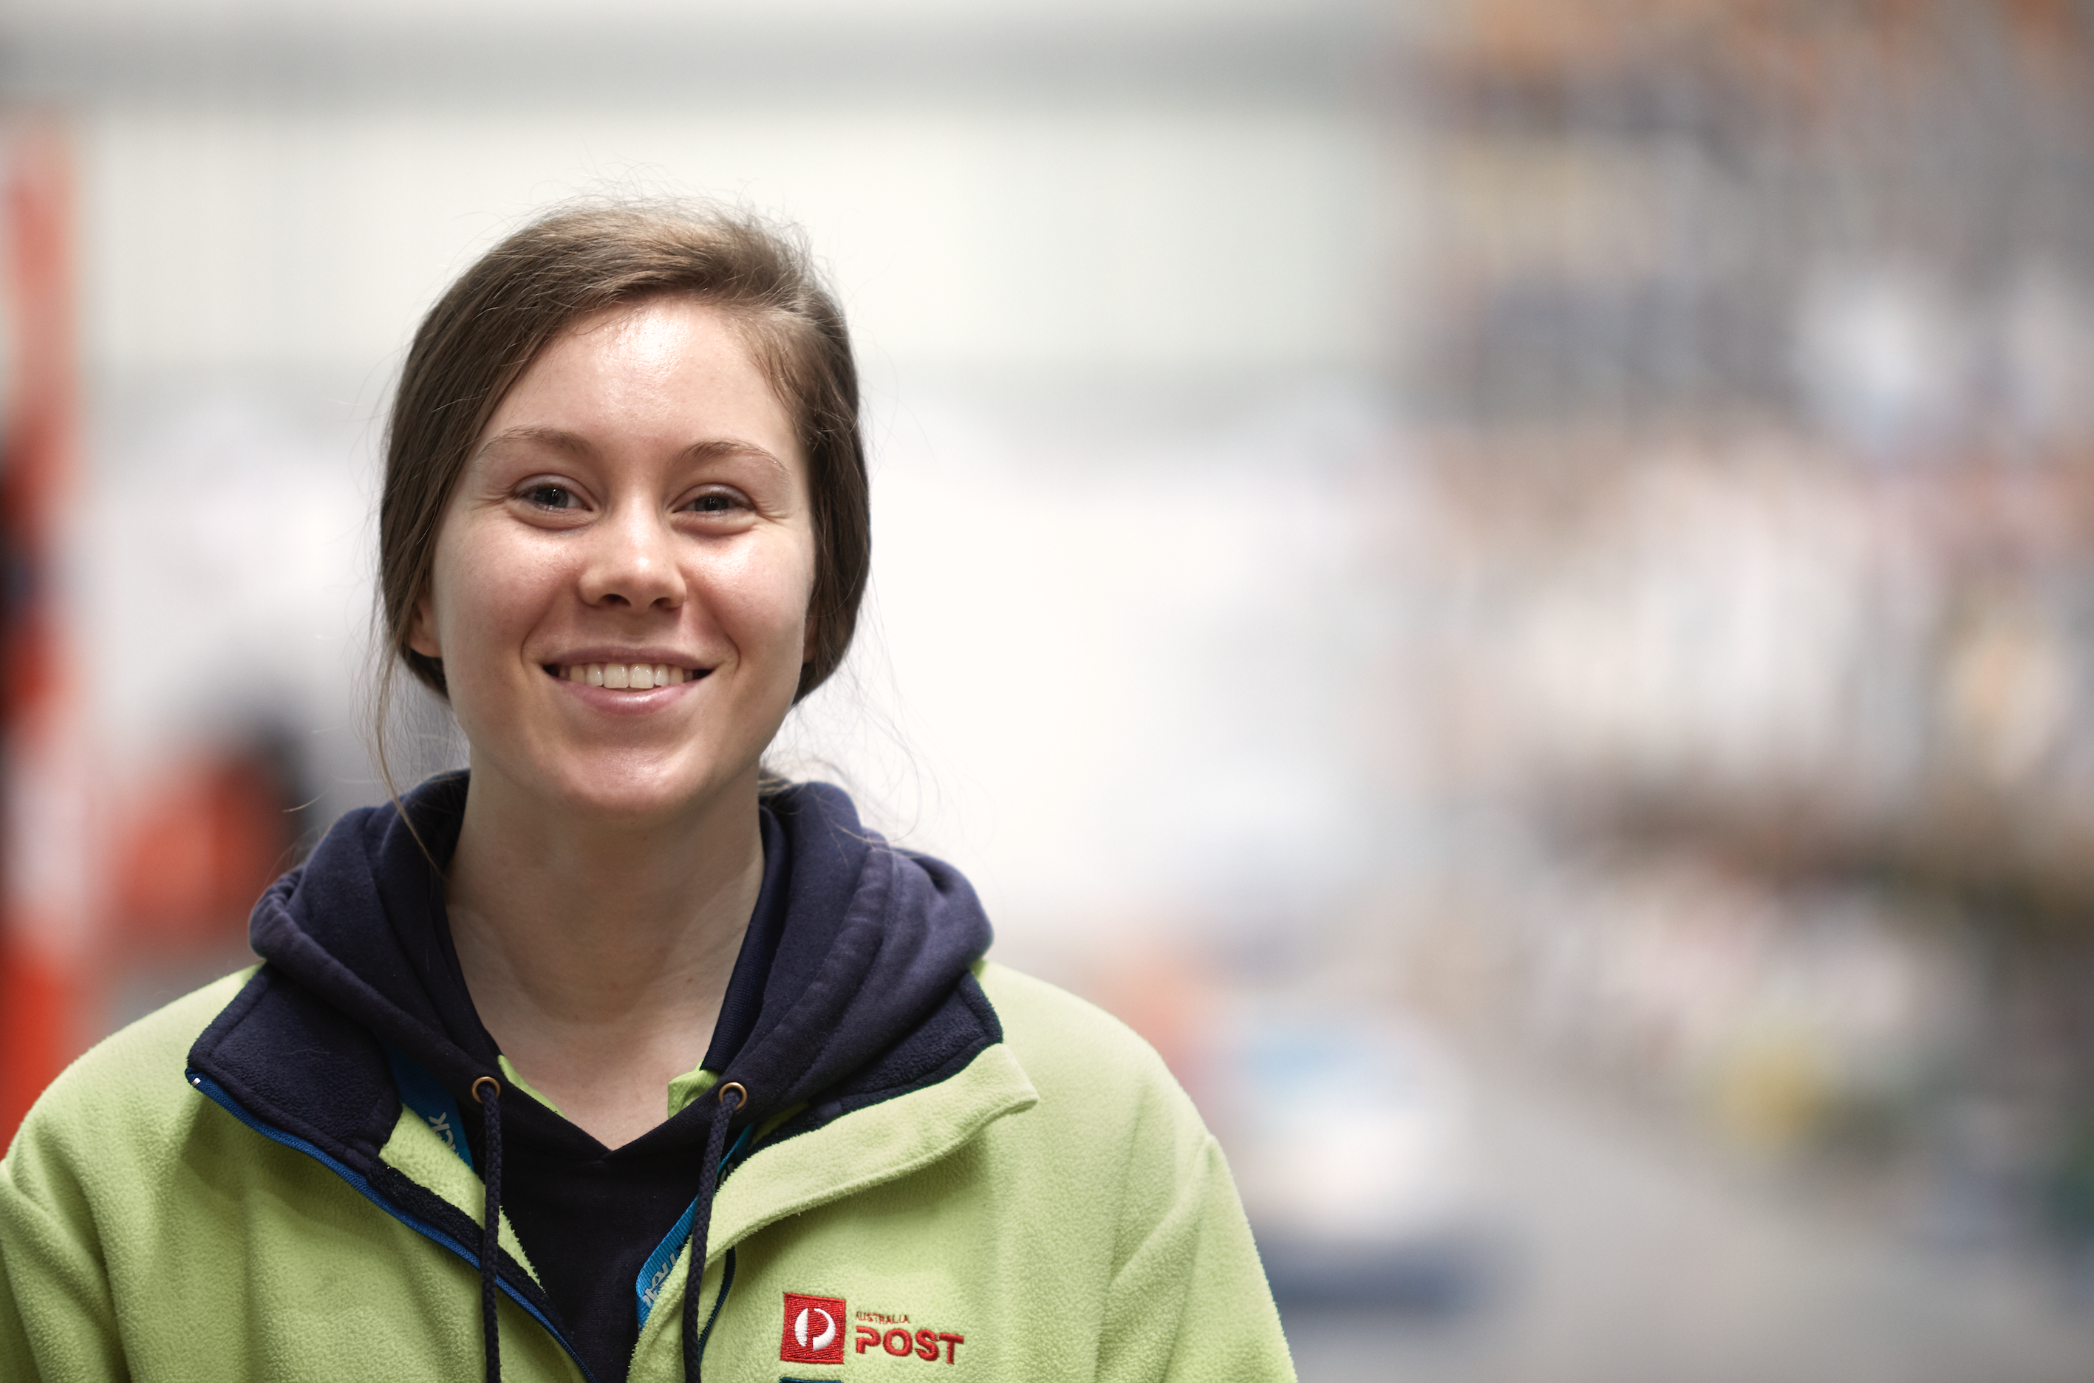
Safety Advocates help with:
Checking In on workmates wellbeing
Identifying hazards and risks in work zones
Maintaining the safety focus during PEAK
Helping maintain our COVID social distancing, masks & zones
Buddying up with new starters
Completing Safety Go See Walks and giving feedback
Working with site management, HSR’s and Safety Specialists to improve safety

Slide 3
As a Safety Advocate, some of the best actions you can take are by looking out for your work mates so that they complete their tasks safely.
This might be good manual handling practices, taking a gate out of ULD safely, following our COVID controls or checking in on their wellbeing.
Here are some key steps to help with planning your activities:
Have a conversation with your site management on the areas that they would like help with during PEAK.
Complete the Safety Advocate Planning Template
Have a read through the supporting slides to help with additional tools that you can use.

Slide 4


Planning your activities
 | FOCUS AREA | DETAILS
 | We will Identify Hazards, Near Miss events and Incidents | All events will be entered into One Safe and communicated with my supervisor
 | We will complete Safety Walks | We will use the Safety Walk (Go See) tool, communicate with my Supervisor and record actions
 | We will Involve others in conversations about risk | We identify ways to involve our work colleagues in conversations about risk and safety
 | We take time to reflect on what we have learnt | We discuss what we have learnt and communicate improvements with our team through Good, Better, How
 | We will reach out for support where needed | We will speak with our HSR or manager where we need further support to help create improvement
Safety Advocates are essential part of our safety community that help our work mates through having conversations about hazards and risks, recording improvements and looking out for the mental wellbeing of others.
EXAMPLE
Before you commence your work as a Safety Advocate it is important to coordinate a meeting with your facility’s management team, HSR’s and DHSR’s to develop the key areas that you will be focusing on. The table on the right provides an (example) of the key focus areas.
EXAMPLE
EXAMPLE
Before you commence as a Safety Advocate, develop your key focus areas and details for your facility and communicate this with your teams on how you will be helping. Schedule in regular reviews with your management team on how you are progressing and celebrate the wins you have. You can Use the Good, Better, How template in the Appendix to check in on your progress.
EXAMPLE
If you need more information please contact your Safety Partner

Slide 5
(Facility Name)
Safety Advocate Planning Tool
After you have filled this in, remember to schedule in progress reviews. You can use the Good, Better, How tool to do this. It can be as easy as asking What has been Good? What could be better? and, How will we do this? The tool is supplied in the Appendix.
(Facility Name) Safety Advocates |  | Date (00.00.0000)
Enter names of Safety Advocates in this area
 | FOCUS AREA | DETAILS
 | Enter Focus Area | Enter details
 | Enter Focus Area | Enter details
 | Enter Focus Area | Enter details
Notes:
Complete this template with the site Safety Advocates and communicate it on site so that your workmates are aware of your activities.

Slide 6
Supporting Tools
The following slides can be used to help with:
Request for Safety Advocates
Our TIES Values
Identifying Hazards and Risks (videos that you can watch and discuss)
What's in a Safety Conversation?
Conducting a Safety Walk
Recording details in One Safe
Good, Better, How Tool
Pause, Breathe, RESET
One Safe Instructions for mobile users

Slide 7
Would you like to be a
Safety Advocate?
Activities that Safety Advocates help with:
Safety Advocates help during PEAK by identifying safety hazards and risks including prioritising the physical and mental wellbeing of others. They work with HSR’s and site management to take action.
Identifying hazards and risks in work zones
Maintaining the safety focus during PEAK
Being in work zones when new processes have been implemented
Helping maintain our COVID social distancing, masks & zoning requirements
Buddy up with new starters to help them with site safety requirements
Completing Safety Go See Walks and giving feedback to HSR’s and site management
If you would like to be a Safety Advocate please place your name below. We will be providing further information shortly.
Notes:
One page document that can be printed to communicate details about being a Safety Advocate. This can be placed onto noticeboards, used in pre starts or Toolbox meetings.

Slide 8




Our values What we stand for
Our Purpose – Connect people with each other and the world.
We unlock opportunities for everyone.
At Post our Leadership Behaviours are aligned with our TIES values. These Leadership Behaviours and Values provide the foundation for everything we do, the services we deliver, the products we provide, and how we communicate with each other and our customers.
Post’s desired culture
Leadership Moments
The conversations you do and don’t have, the behaviours you do and don’t display, the actions you do and don’t take – really matter. The choices you make in these moments create a ripple effect, which impact your people, our business, our customers and our communities.
Leadership Expectations
Key Accountabilities
‘what you do’
Setting expectations, holding my team to account and recognising their contribution
Ensuring my team has the information, skills and experience to do their job
Supporting my team to achieve their career and development goals, regularly checking in
Establishing operating rhythms to enable the achievement of our objectives
Addressing workplace changes, incidents and conflicts in a timely and consultative manner
Managing my team’s people information and data
TIES Leadership Behaviours
‘how you do it – that role models our values’
Proactive feedback - Provides and seeks regular, constructive feedback, both reinforcing and developmental
Takes ownership - Does what they say, owning mistakes and asking for help
As a Safety Advocate it is important that you practice and promote our TIES Leadership Behaviours with a focus on Safety Conversations and Prioritising Safety
Inspires others - Understands and values the unique contribution each person can make
Connects with others - Knows people, creating connection with and for others
Empowers others - Sets direction and boundaries, delegates, then gets out of the way
Curiosity - Gets curious and genuinely listens - asking more, telling less
Safety conversations - Asks questions to help others identify safety risks and take action
Prioritises safety - Makes decisions to prioritise the physical and mental wellbeing of others
Notes:
Provide details on our Safety leadership expectations.

Slide 9
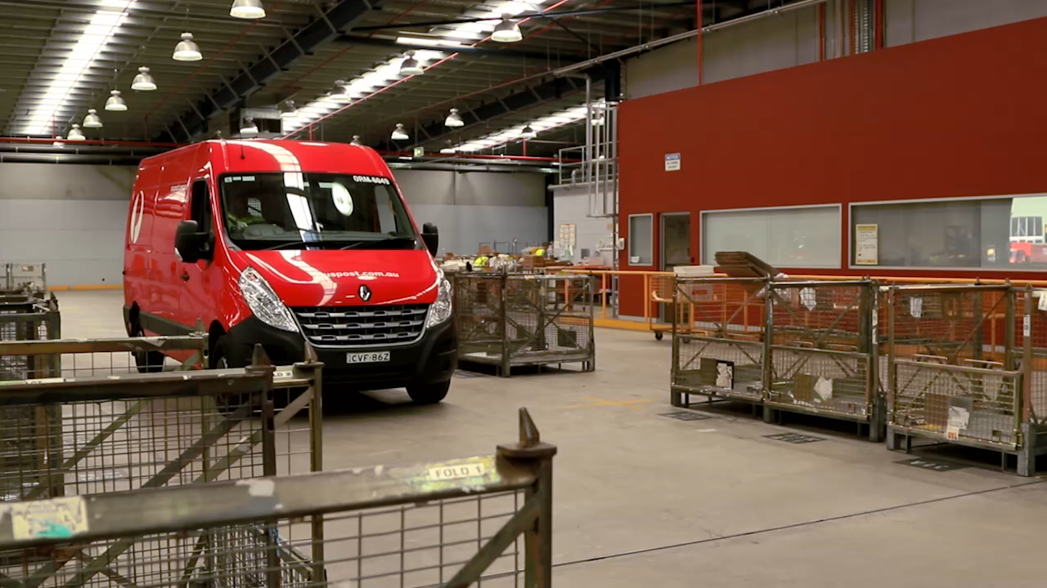
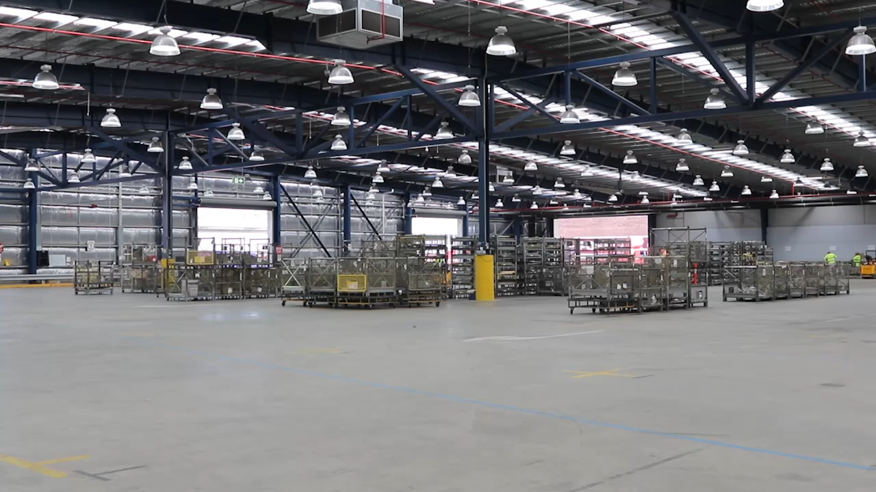
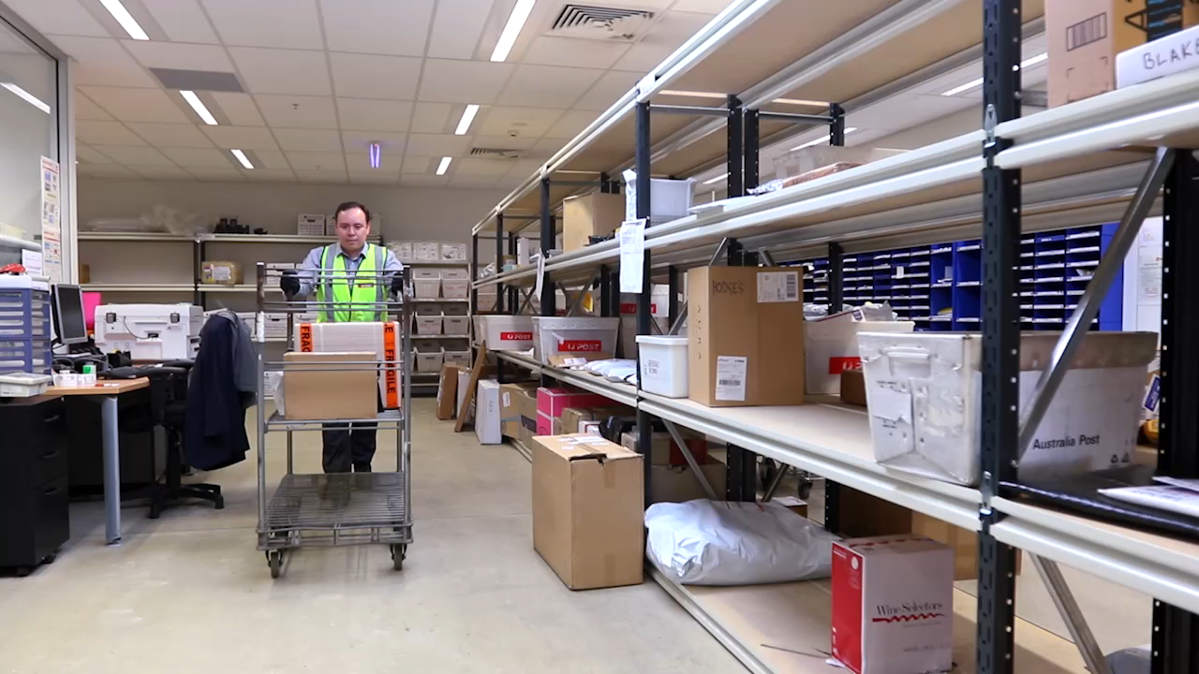
Identifying Hazards & Risks
A (HAZARD) Is anything with the potential to cause harm to a person, property, equipment, or a combination of these.
Each workplace has its own hazards and risks that are unique to them. Take a look at the videos on this slide and have a conversation with your team mates about what hazards and risks do you see, what worked well, and what action (controls) you would take?
A (RISK) can be defined as the likelihood of something happening due to the interaction with the hazard and the potential consequences of that interaction.
Whilst your Safety Partners, HSR’s and DHSR’s can help you with the technical part of safety you can make a significant improvements by helping your work mates with identifying hazards, risks and taking improvement action.
When identifying Hazards and Risks, think about Critical Risks. These are, risks that could cause a fatality or life changing injury, for example; forklift/pedestrian interaction or product (inc ULD’s) being stacked with the potential to fall.

Slide 10
1. HOW TO CHECK IN
Why provide details on how to have a safety conversation?
Before you complete your walk, plan what area you will look at, who you are going to talk with and at what time. You might be focusing on manual handling, LSE, COVID controls, or 5s for housekeeping. Before you start a conversation, remember to PAUSE: Set a helpful mindset and introduce yourself. BREATHE: Take a deep breath, focus on the conversation and the environment.
2. WHAT TO ASK
Having effective safety conversations is a central skill and essential for a strong safety culture.
Even though we have a range of tools to help us, we need to be able to have a conversation to understand the task the person is doing and what hazards and risks they see (and the ones they don’t).
This means that we need to check in.
Use open questions Can you tell me..? Can you step me through..? What are the risks for this task? What controls are in place? What do you need to do to be safe?
3. WHAT DID YOU HEAR & SEE
What words are they using to explain the job? Is it a clear process? Is the area clean and tidy? Do they communicate well with others?
4. RESET – TAKE ACTION
Be conscious of your own bias/perceptions. If you hear rushing words, raise this with them. Check that they know where to find details/assistance. Ask them what action they are taking to be safe?
If you see something that is dangerous, stop the activity and notify the supervisor. Always thank people for the conversation.
Have a practice of the steps on this page. The details are also in your Safety Walk Go See card.
Open Questions
Can you talk me through how you do this task?
Can you step me through what the key hazards are?
How have you controlled the risks in this area?
How do you work together as a team?
What do you normally do to help each stay focused?
During your conversations, its good to ask Open questions. Open questions require multiple word, or free-form answers based on the person’s feelings, thoughts or knowledge. Here are some you can practice:

Slide 11
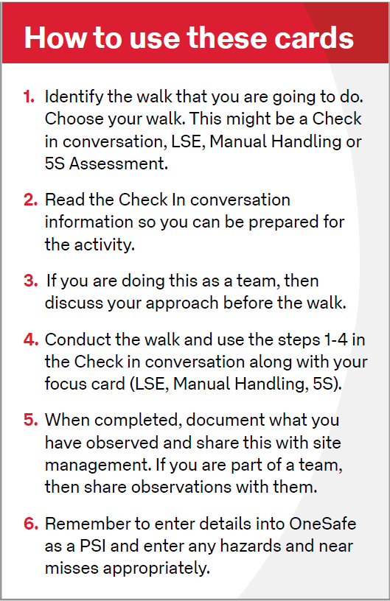
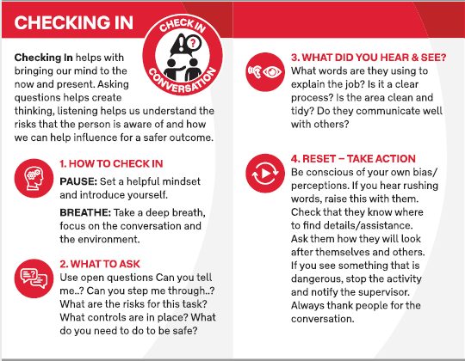
An introduction into conducting a Safety Walk?
STEP 1
STEP 2
Safety Walks help identify potential hazards and risks within our workplaces.
To help with completing a Safety Walk we have developed some visual reference cards. The cards focus on critical risks and were developed through an evidence-based process.
Read through the steps on the right on how to complete a Safety Walk

Slide 12
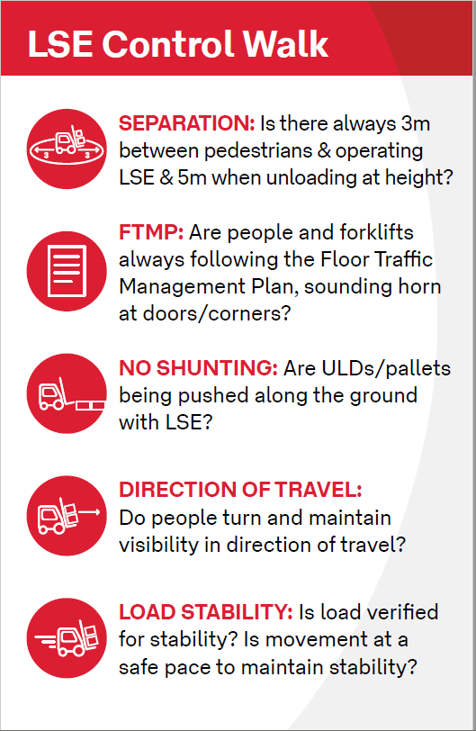
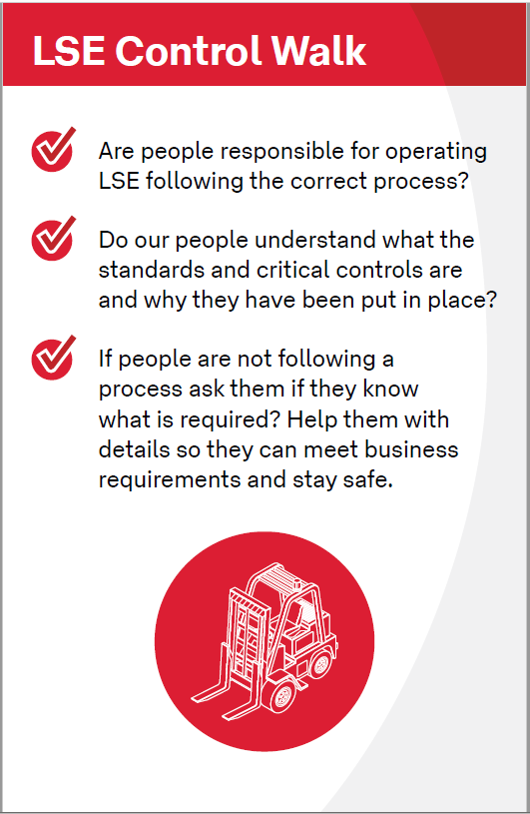
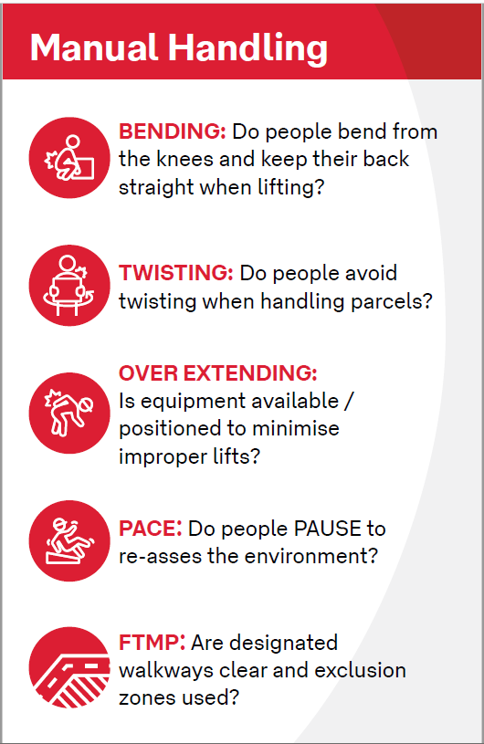
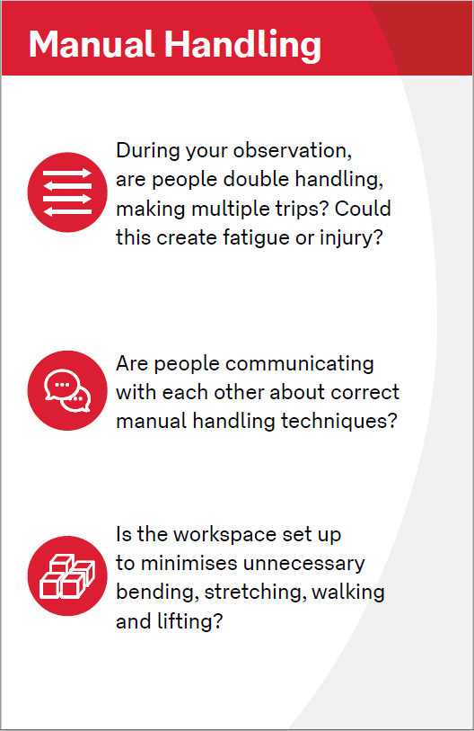
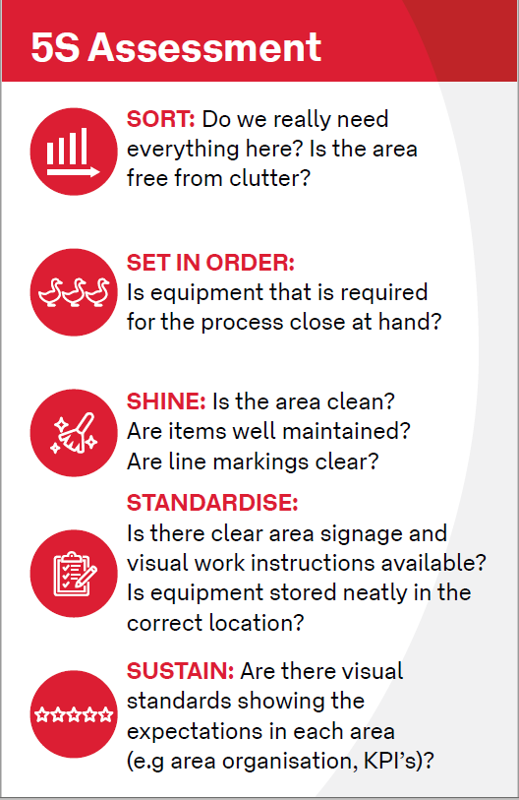
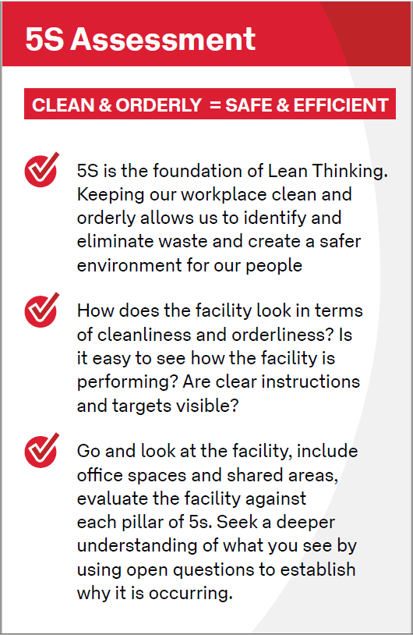
Safety Walk Options
STEP 3
Each of the Safety Walks have a double sided card with key focus areas. Work through each of the items when you conduct your walk

Slide 13
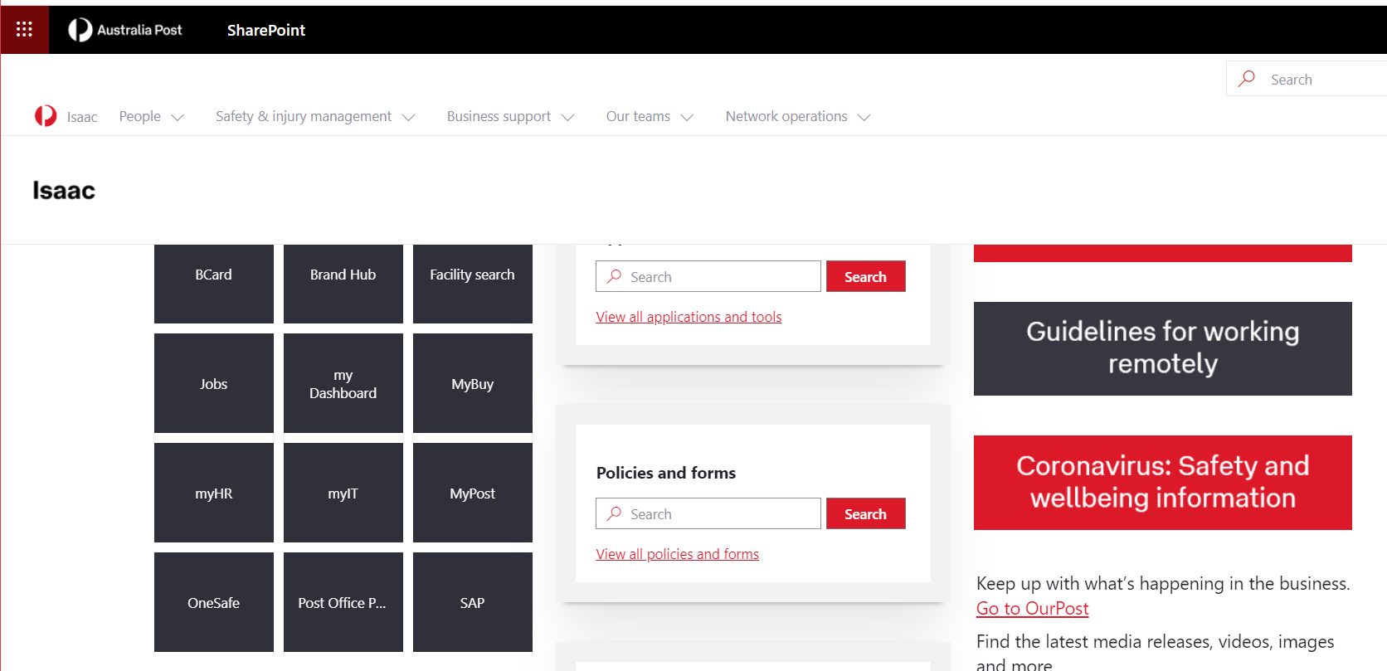
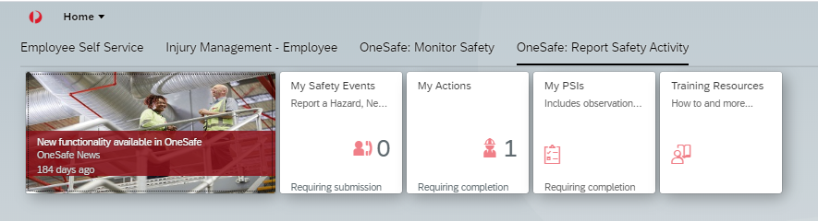
STEP 4
Documenting your activity
As we identify hazards and risks, it is important to document this and capture the improvement actions. At Post we use the PSI process through the OneSafe Framework.
To access OneSafe go into the Issac web page and select the OneSafe button
At the top of the screen you will have four tabs. The last tab (OneSafe: Report Safety Activity) will provide access to My PSI’s
You can select the My PSI button to create a PSI
If it is your first time completing a PSI, your Safety Partner can assist you.
Note: Your Team leader, Supervisor or HSR can enter details into OneSafe for you as well.

Slide 14
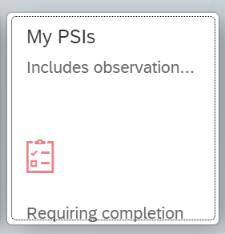
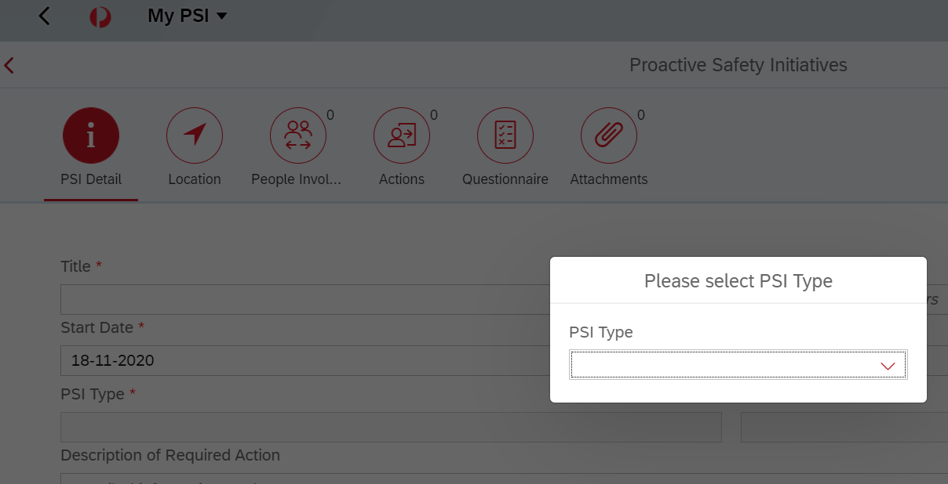
STEP 5
Recording data into OneSafe
Go into OneSafe and select the My PSI’s button:
Select the Create button and choose the (Behavioural Observations) from the drop down list

Slide 15
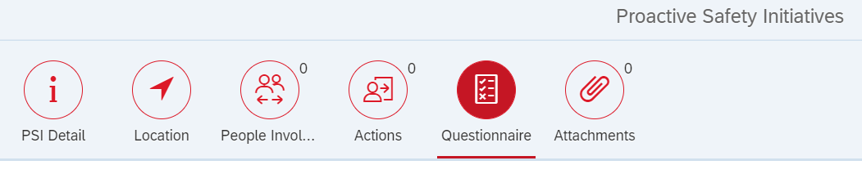
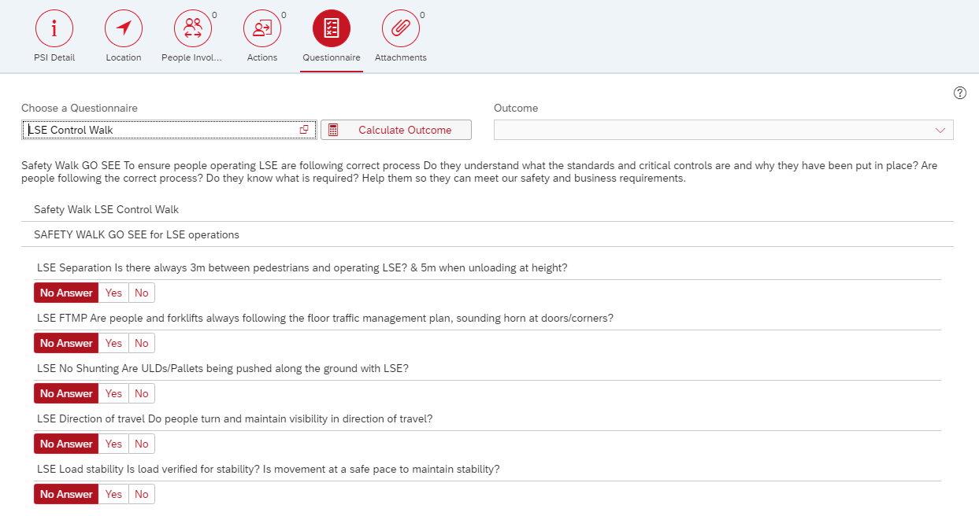
Recording data into OneSafe
Go to Questionnaire and select the Safety Walk you want to record. For example; 5S Assessment Safety Walk, Manual Handling Safety Walk, or LSE Control Walk.
You will then be presented with the same details that are printed on the Safety Walk cards. Work through each question and enter your response. Any non conformances will require an action to be created.
Remember to share what you have identified with site management so that the details can be communicated, actioned and reviewed.

Slide 16
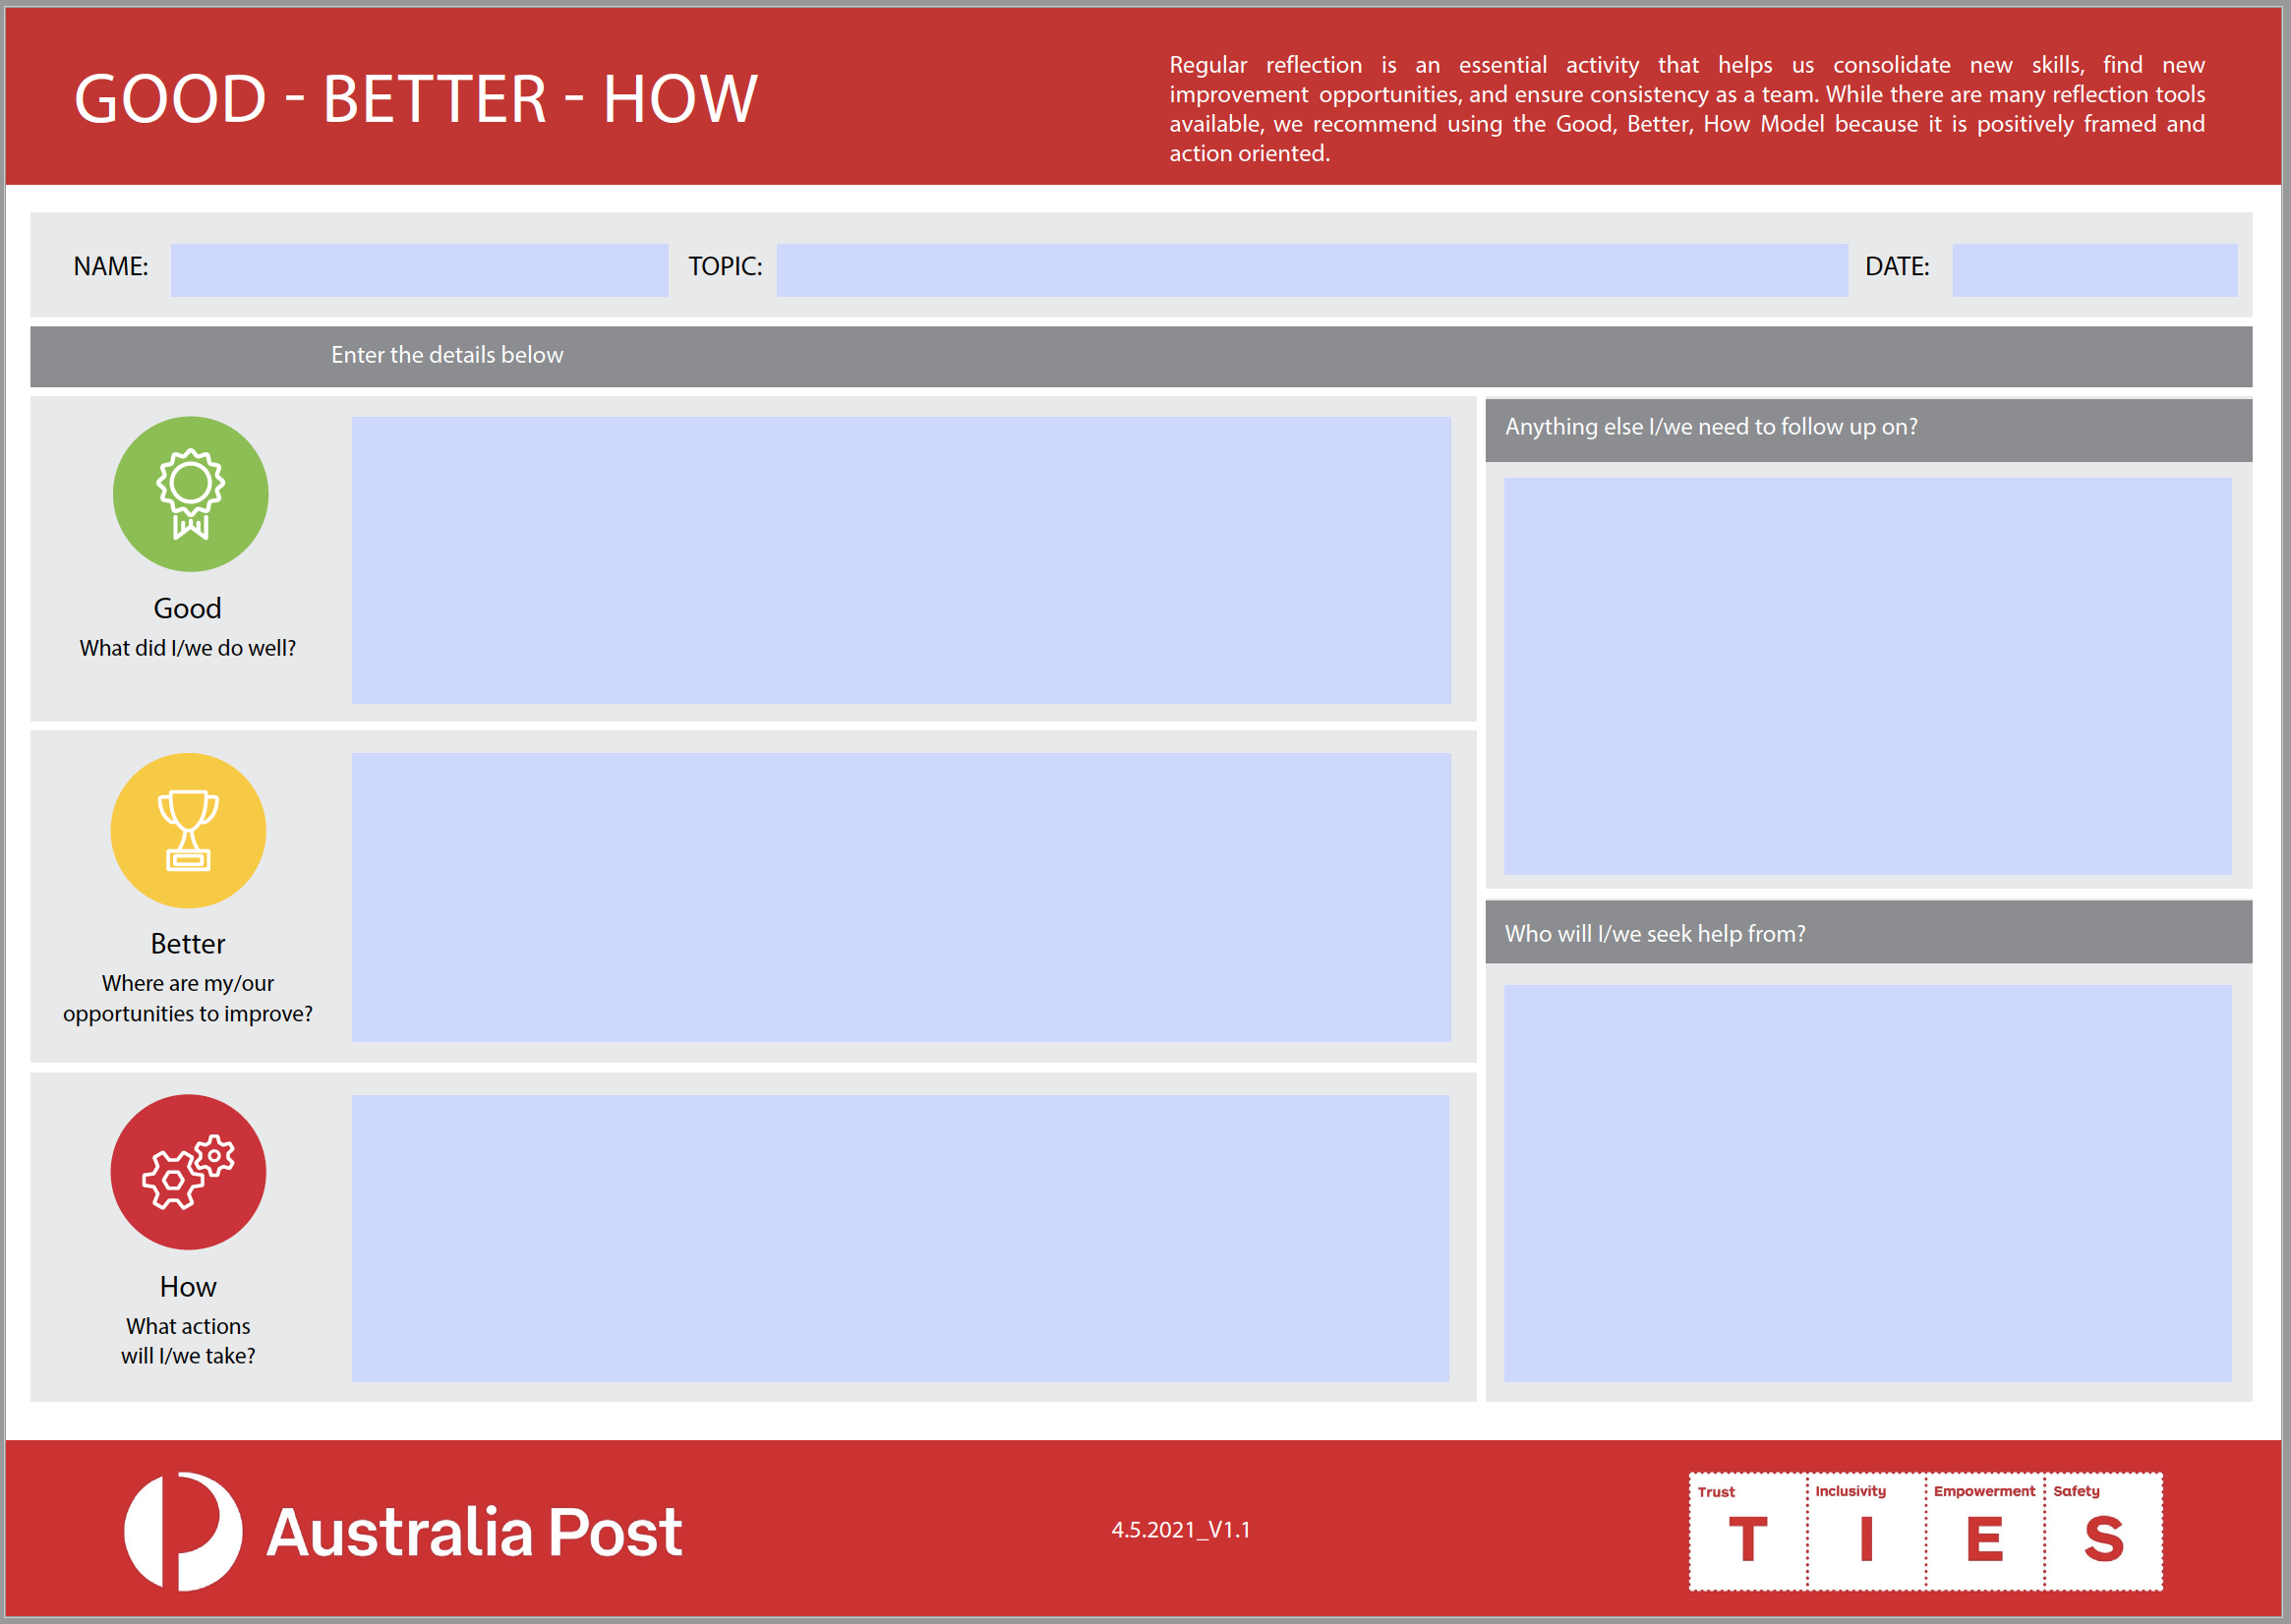
Good, Better, How?
An activity that be very helpful is to complete a Good, Better, How to review how you went when you completed a Safety Walk Go See, a meeting or reviewing a plan.
You can reflect by your self or ask a colleague to provide you feedback. We have an A4 Good, Better, How template that can be used for these activities.
As part of PEAK, schedule in a Good, Better, How with your Safety Advocates.

Slide 17
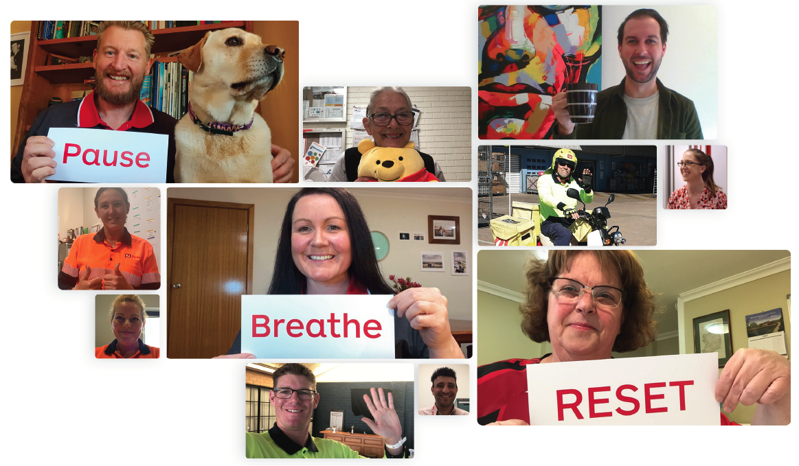
Remember to:
Pause, Breathe, RESET
One of the most important things we can do now is take the time to Pause and remember what’s important to us and the connections we have in our Post family. A quick and easy activity we can do is practice Pause, Breathe and RESET. How this works is:
PAUSE whenever we notice we have become stressed or distracted, before we operate equipment, handle parcels, or attend a meeting.
BREATHE – A 4 second breath. Breathe in deeply for a count of 2, and out for a count of 2.
And RESET our attention back to the here and now
It takes less than 10 seconds to do this and helps us feel better, reduces stress, and increases focus. The best thing about this is that you can do it anywhere, anytime, even now.
Identify how you will include Pause, Breathe, RESET into your Safety Advocate plan.

Slide 18
OneSafe Instructions for Mobile Users

Slide 19
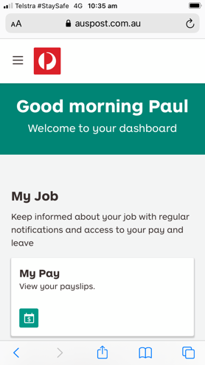
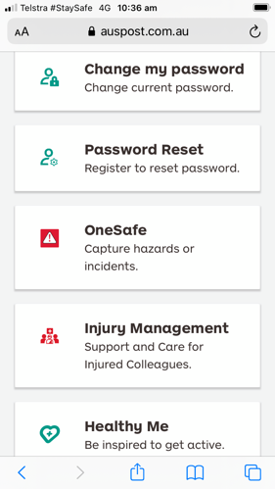
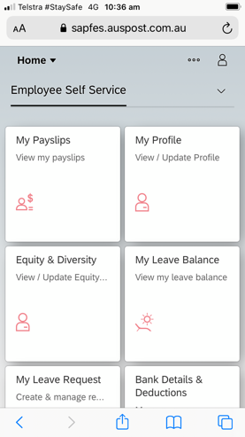
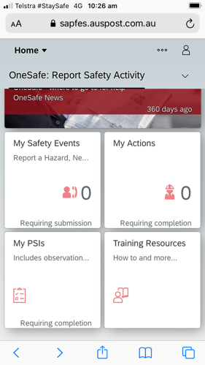
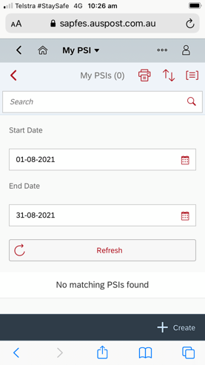
Instructions for Mobile Users.
The following provides an example of how to complete a Safety Go See Walk using a 5s example.
1.
2.
3.
4.
5.
On your mobile go to your Dashboard on: ourpost.com.au
Scroll down to “OneSafe”
& click
Scroll down to “My PSIs”
Click on
“My PSIs”
Click
“+ create”

Slide 20
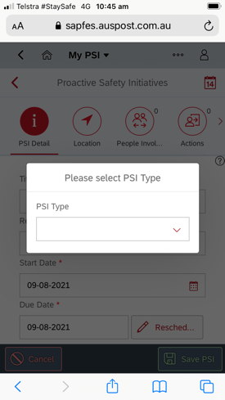
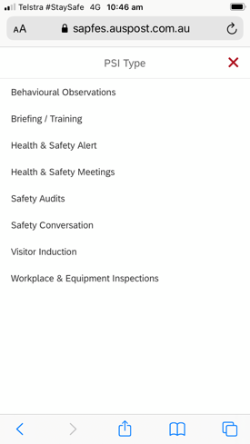
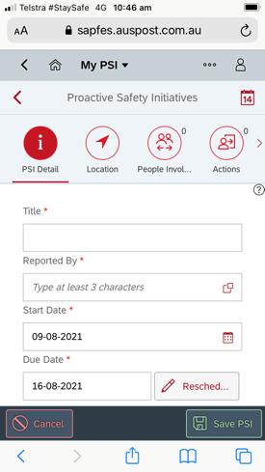
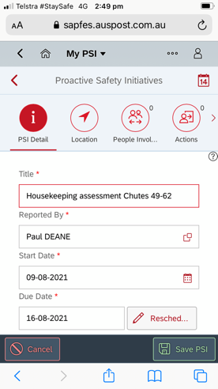
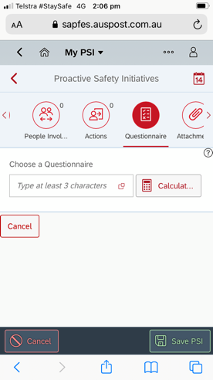
Instructions for Mobile Users.
6.
7.
8.
9.
10.
Click on the drop down menu arrow
For 5S Assessments select “Behavioural Observations”
Each time you see this icon it refers to a drop down menu
Complete the first page and continue to scroll through the top icons completing the information as you go
When arriving at the “questionnaire” tab click on the menu icon

Slide 21
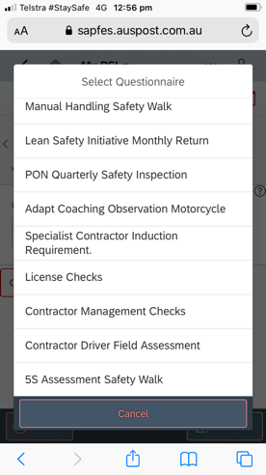
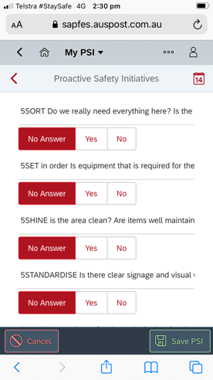
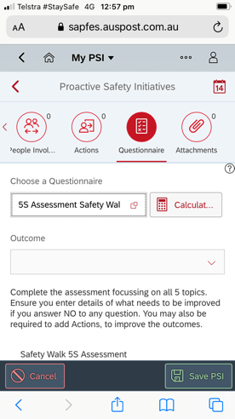
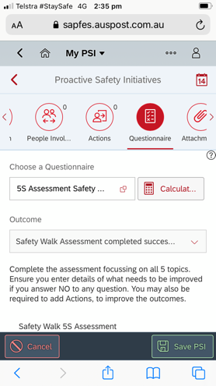
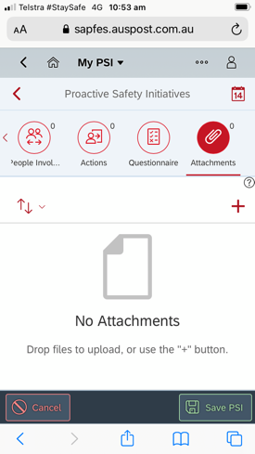
Instructions for Mobile Users.
11.
12.
13.
14.
15.
From the drop down menu select your Safety Go See Walk
Answer all the questions
Scroll back to the top & click the “Calculator button”
The Outcome will be displayed
Go the final tab and click “+” to attach photos to represent your observations

Slide 22
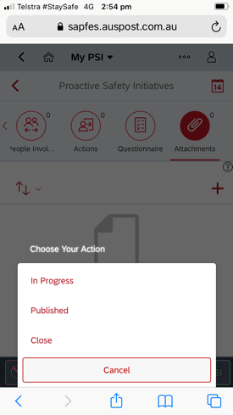
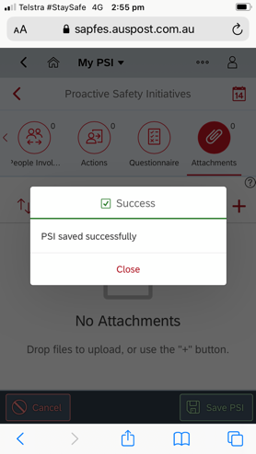
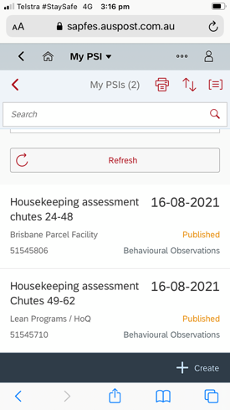
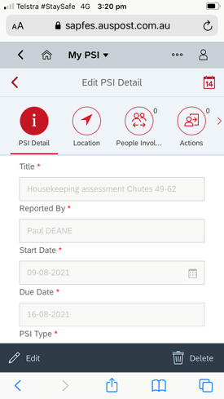
Instructions for Mobile Users.
16.
17.
18.
19.
20.
When finished click “save PSI”
In Progress: Will save the PSI so that you can add details/actions
Publish: Provides the option of completing in the future
Close: Saves the PSI and indicates that all items have been completed.
Close the PSI to revert back to the original menu”
PSI completed.
Returns to the home screen, where current PSIs are listed
Any can be edited or deleted from this page

