Slide 1
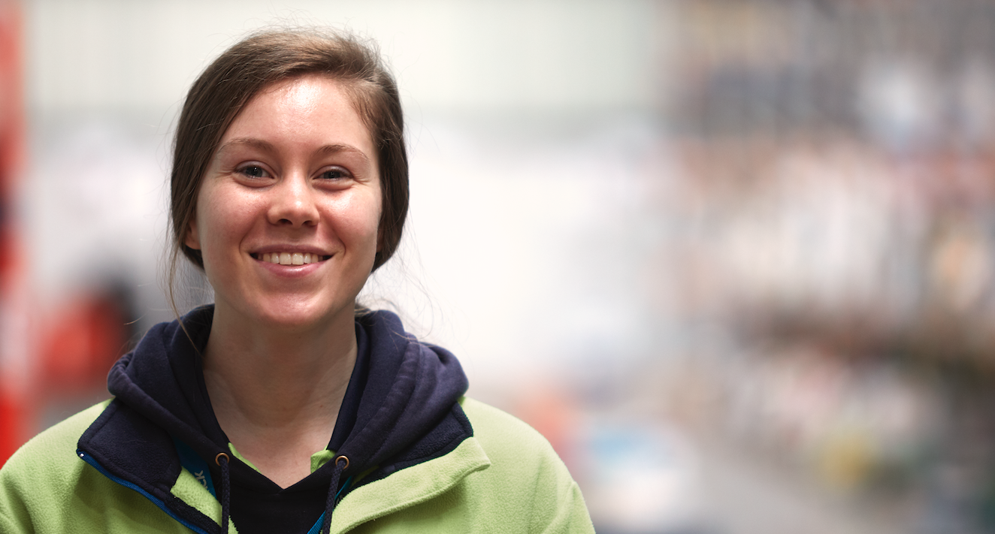

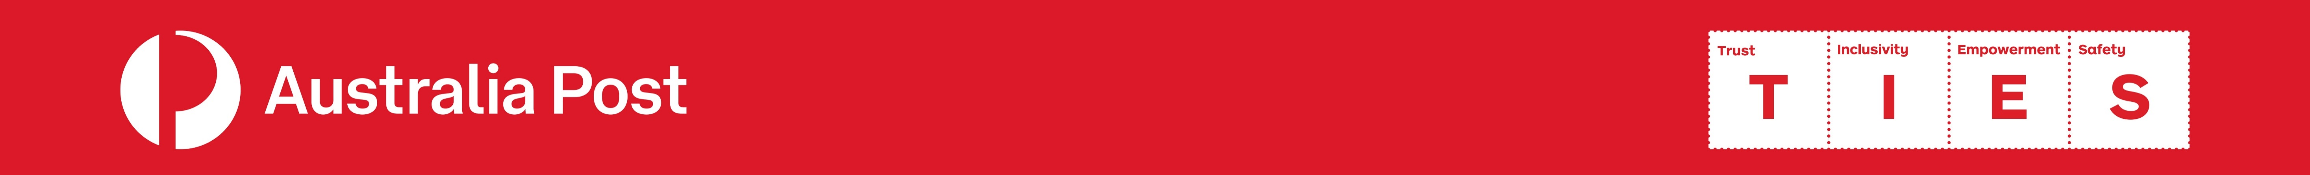
Version 1.4 - 31.5.2022
1

Slide 2
During June 2022, we would like you to:
Resources:
To help with creating ideas and to support you and your team, you can choose from the following resources:
Share this presentation with your team.
Have a conversation about how you use Pause, Breathe, RESET at work.
Post your photos, videos up onto Yammer with the hashtag #PBR.
This presentation that you can share to communicate details.
An A3 poster that you can use to write down your ideas.
A Pause, Breathe, RESET A4 template to collect ideas from your team.
A web page that has these resources: https://ourpost.com.au/safety-wellbeing/keeping-you-safe/pause-breathe-reset
The go live date for this activity is Wednesday 1st June 2022, and will close on Thursday 30th June.
2

Slide 3
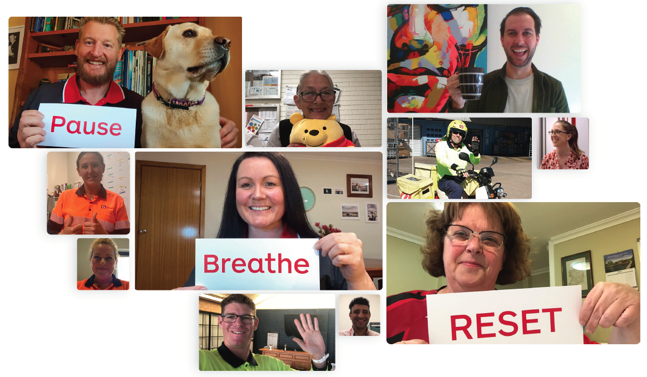
Pause, Breathe, RESET is a safety process based on mindfulness, which helps us focus our attention to improve our conscious decision-making.
The Pause, Breathe, RESET tool asks us to:
PAUSE whenever we notice we have become stressed or distracted, before we operate equipment, handle parcels, or attend a meeting.
BREATHE – A 4 second breath. Breathe in deeply for a count of 2, and out for a count of 2.
And RESET our attention back to the here and now.
It takes less than 10 seconds to do this and helps us feel better, reduces stress, increases our focus and our attentional capacity – i.e. our awareness. The best thing about this is that you can do it anywhere, anytime.
3

Slide 4

Some Interesting Facts
With all that information, research suggests that we can only pay attention to a tiny amount (about 0.2%). This means that we miss more than 99% of all incoming information.
Pause, Breathe, RESET is based on brain science. And while our brain is incredibly complex, some relatively simple rules govern its operation.
3. We can only focus on one thing at a time:
1. We are designed to conserve energy:
Our attention works much like a torch beam. When we walk in to a dark room, we will only see what the torch beam is shining on – everything else will be dark.
When we think we’re multitasking, we’re actually shifting our attention from one task to the next – sometimes extremely quickly. This takes energy, which means that over time the quality of our attention reduces.
As human beings we are programmed to survive feast and famine. This means that we are designed to conserve energy. Developing habits and operating from autopilot are great ways that our brain conserves energy. Have you ever driven home and forgot how many turns you took or the colour of the car in front of you?
2. We have limited attention:
Practising Pause, Breathe, RESET helps with:
Every moment in time our brain is flooded by information. There’s information that comes from inside of us – such as our heart beating and blood pumping, and information that comes from outside of us – such as the light and what’s going on around us.
  the way we see and manage hazards
  our general performance and error reduction
  stress management and improved morale
  improving safety performance.
4

Slide 5

Have a go at the following
Play the video on the right.
Place your mouse at the bottom of the video to play.
5

Slide 6
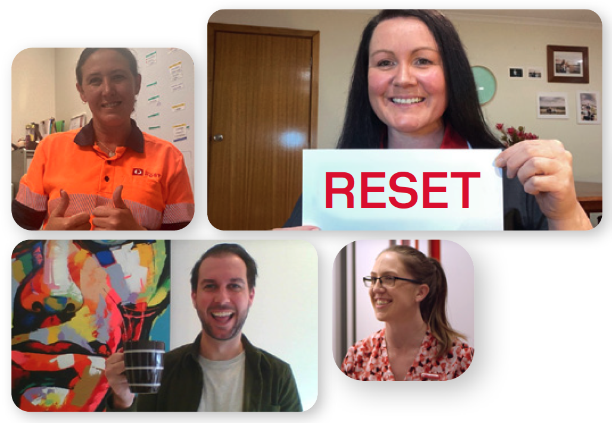
So often the changes we face in the workplace are small or slow changes over time. Or, when our environment changes rapidly, such as a car pulling out in front of us, when we are distracted. As an example have a read through the following questions.
Did you see the changes?
Have you ever missed a hazard such as a pot hole, low hanging tree branch, garden bed or phone pit when operating and EDV or motorcycle?
When unloading a ULD or loading a trailer do you always use correct manual handling techniques?
When operating a van, truck or prime mover do you scan the area before driving out into traffic?
Do you always drive to the conditions including safe stopping distances?
Have you ever been loading a trailer and you are so focused on the task that you have not noticed the driver come within 3m?
Have you ever pulled up to a house and been so focused on the scanner and parcel that you have missed a broken step or the “dangerous dog” sign on the gate?
So, why didn’t we see the change in the video?
  Because our brain conserves energy.
  We have limited attention.
  Our energy goes to focusing on one thing at a time.
This is where comes in.
Lets have a go together:
PAUSE
BREATHE A 4 second breath. Breathe in deeply for a count of 2, and out for a count of 2.
And RESET our attention back to here and now
6

